Slide 1
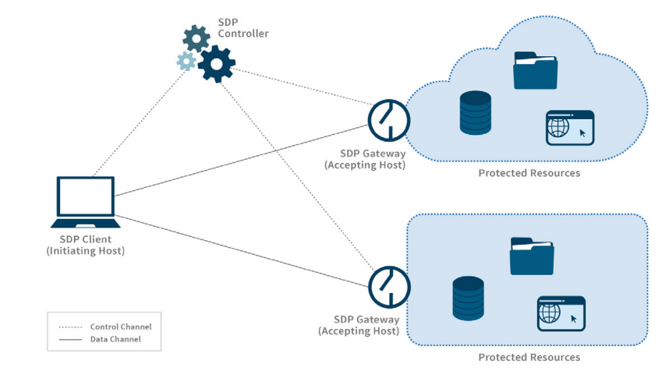
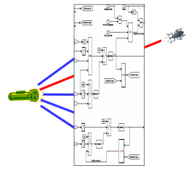
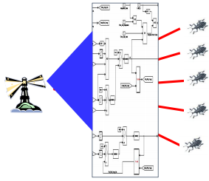
Specifying and Verifying SDP Protocol Based Zero Trust Architecture Using TLA+ dong.luming@zte.com.cn
VS
Traditional Test
Formal verification
Notes:
Hi, I am luming dong from ZTE company, China
Today I want to talk about how we use TLA+ to specify and verify SDP protocol based zero trust architecture.

Slide 2
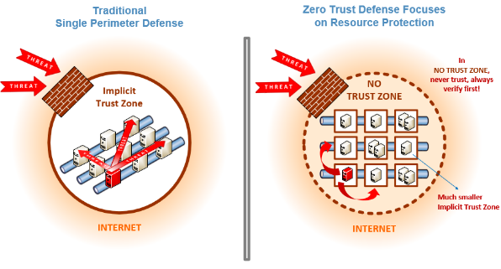
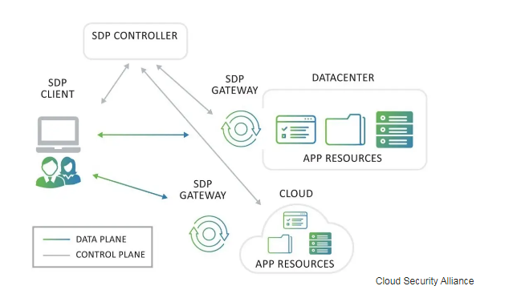
SDP oVERVIEW
Zero Trust Concept
SDP (Software Defined Perimeter) Architecture
Notes:
Let’s first understand what are Zero trust and SDP.
Zero trust is the term for an evolving set of cybersecurity paradigms that move defenses from static, network- based perimeters to focus on users, assets, and resources,which uses
zero trust principles to plan each access flows.
And SDP, which is the abbreviation of “ Software defined Perimeter”,is a prevalent security framework designed by Cloud Security Alliance (CSA) for Zero Trust Network Access (ZTNA) ,
it aims to build a virtual boundary for enterprises in a software-defined way in the context of mobile access and cloud computing.
The SDP architecture separates the security data plane and control plane of network access, making network services concealed for attackers both inside or outside network environments through enforcement of "Authenticate Before Connecting" policy, ensuring that only users with legal identities, authorized terminal devices and secure network environments can access successfully.
There are a lot of published studies and reserches about SDP in recent years, but few of them give a rigrous mathematic proof to prove its correctness and security properties, so our work focus on verify its security proerties based on
the formal specification language TLA+.

Slide 3
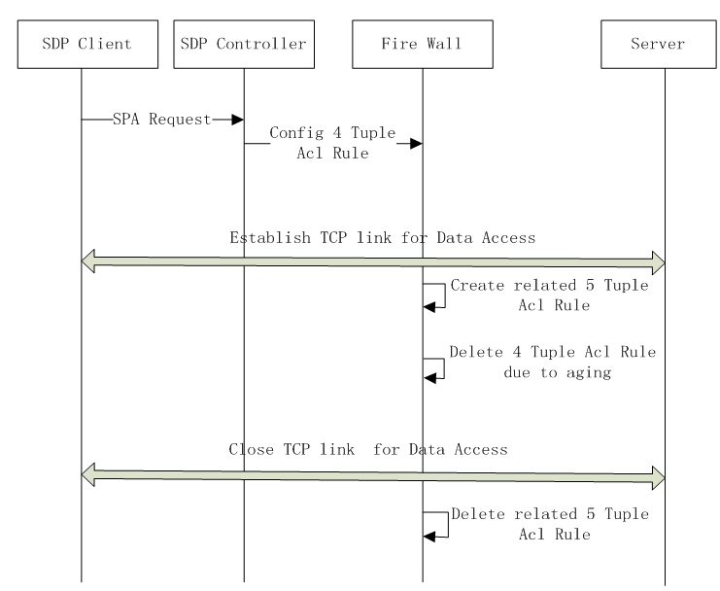
SDP implementation : FWKNOP
Based on common reference architecture and concept defined by SDP specification, various manufacturers in industry provide different implementation solutions, including the prevalent open source project fwknop [4].
SPA is the core security protocol that enables SDP to conceal target service. Before accessing the data plane, the SDP client should initiates authentication towards the SDP controller through SPA protocol.
The key SPA message fields includes the user's IP address, identity credential, target server information for access.
Notes:
After the SDP controller receives the SPA message from the client and grant its access request, it will instruct the SDP gateway to create a firewall permission rule that matches the client's current access, that is, to allow the admitted client to access the target server through the data plane. Since the gateway takes the "drop by default" firewall policy, attackers and unauthorized users can not detect and access the target server, thus additional network service concealment protection is provided.

Slide 4
SDP access control modelling overview
The SDP access control model with attacker
TLA+ modeling process
Notes:
First, we bulit an abstract and extensible SDP access control model to simulate remote access to enterpise's cloud service. This model is defined based on the client-gateway deployment model defined by the CSA specification, with the addition of the attacker's role .
The formal specification will describe all the entities' actions and behaviors includes the attacker.
In TLA+, the state machine of the entire system can be uniformly described by the temporal formula like Spec.
In this formula, Init is the initial predicate, which describes the initial state of the system, and Next is composed of a series of actions, which defines the next-state relation of the system state machine.
And the Next formula can be decomposed into the disjunctions of the actions of the above entities includes the attacker.
After we finish the coding the the spec, we will build model instance and to check if the pre-defined security properties are sataisfied for all the states by model checking,.

Slide 5
MODELLING pRINCIPLES
Bounded Model
In real world, legitimate user can repeatedly initiate accesses to the target server, and attacker can also launch arbitrary number of attacks based on the captured intelligence. This will leads the corresponding abstract state machine to fail model checking due to its infinite state space. Therefore, we constrain legitimate user to only launch limited access to the target service, while attackers can only construct limited attack payloads for each captured intelligence. In this way, the state space of the model is bounded, and model checking can be used to complete the verification.
Abstract
For this model, we mainly focus on the security and correctness of the SDP architecture design, so attackers will not challenge the security properties of standard cryptographic algorithms.
For cryptographic algorithms such as symmetric encryption and hashing involved in the SPA protocol, they are highly abstracted in the spec, only basic security features such as irreversibility and anti-collision in a limited solution space are simulated. For example, we use basic XOR operation to simulate symmetric encryption.

Slide 6
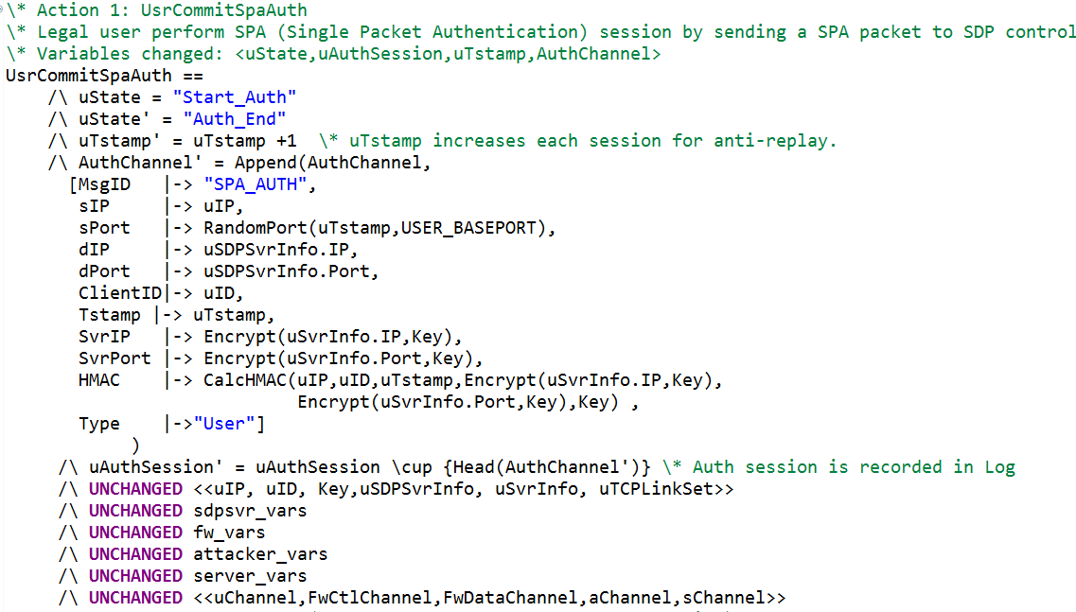
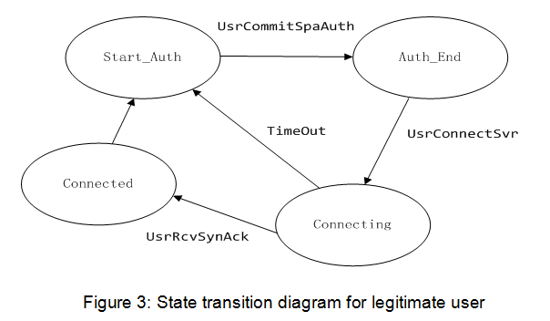
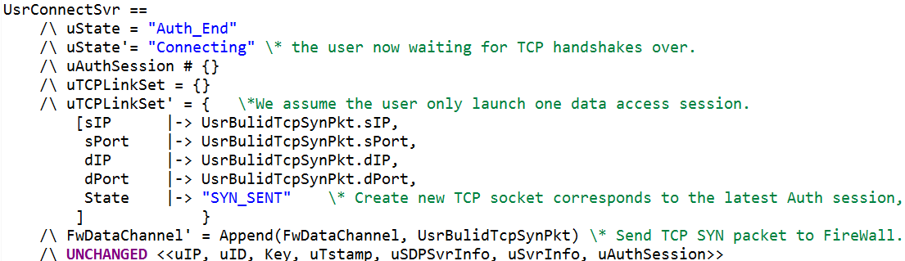
Example: Specification of legitimate user
Action: User Commit SPA Auth
The sending of SPA
(Single Packet Authentication) packet
Action: User as TCP client connect target server
Variable definition for Legitimate user
Notes:
Figure 3 is the state transiton diagram of the legitimate user. After the Init state, the user will first lauch a single packet authentication process to the SDP controller in control plane,
Then it will try to undertake a data access by connecting the target server as a TCP client.
Once the controller authorized its access by inform the SDP gateway to permit its data access, the TCP link between the user and target server will be established, which means a successful
access, ot its TCP connection will fail due to timeout. So , in the data plane, the legitimate user's actions comply to TCP protocol.

Slide 7
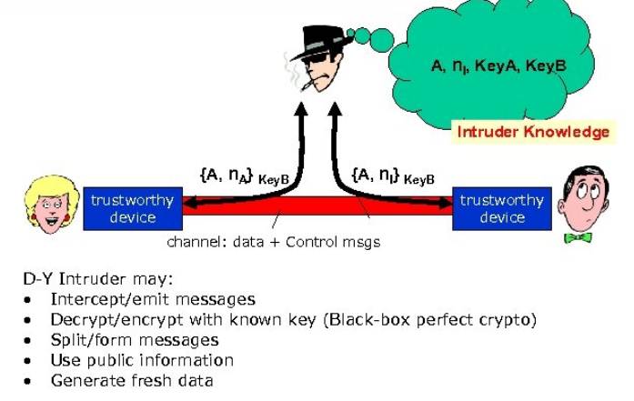
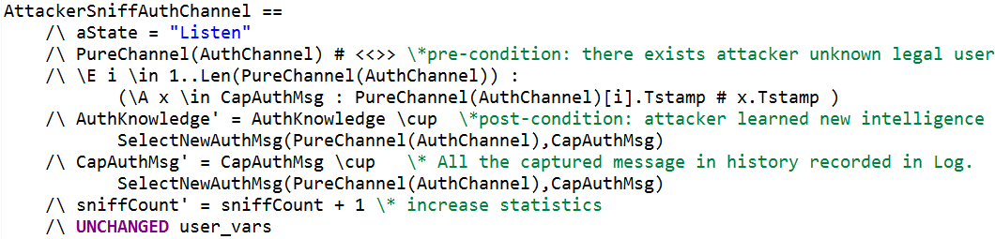
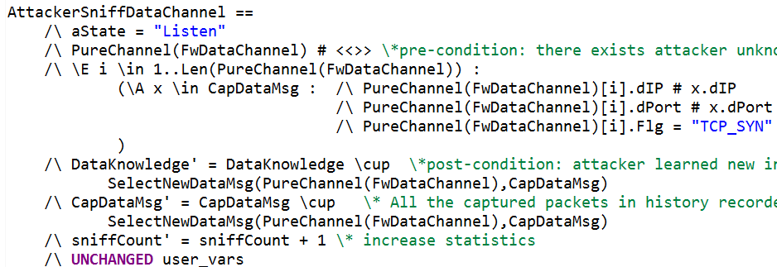
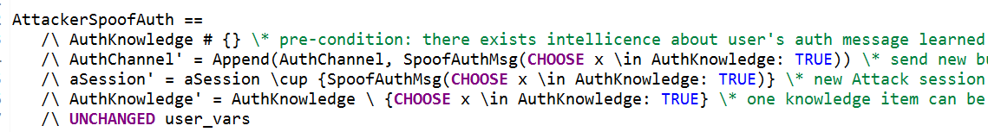
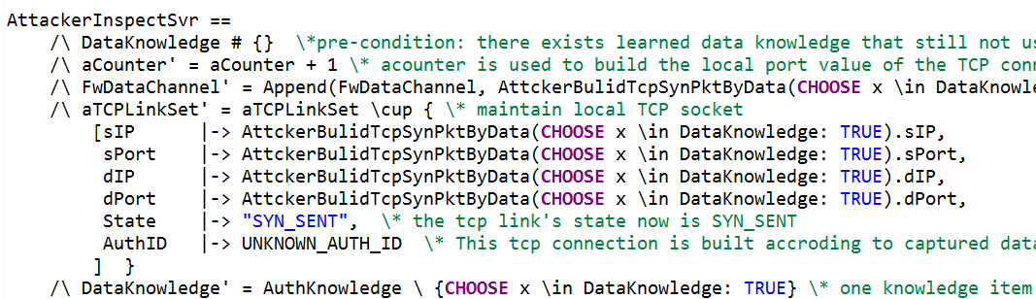
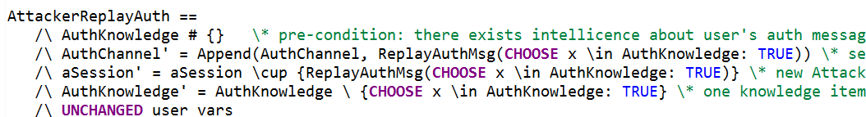
Example: Specification of attacker
The atacker's action based on Dolev-Yao intruder model
Action: eavesdropping SPA message on control plane
Action: eavesdropping TCP packets on data plane
Action: Spoof attack on control plane
Action: Launch service probe attack on data plane
Action: Replay attack on control plane
Notes:
The attacker located in the same local network with the llegitimate user , hence he can capture the packets between legal user and the remote server by sniffing on the LAN.
As a terminal, The attacket not only inherit almost all the ations of the legal user, but also can undertake dedicate attacks based on the captured intelligence.
In general, its attack pattern comply with Dolev-Yao intruder model, which means the attacker has no pre-shared knowledge about the secret between legal user and the target system,
but it can intercept message between them, and hence orchestrate and build attack payload against the target system.
On control plane, the attacker keeps eavesdropping SPA message, to get the authentication info and the access request info from legal user, and then undertake SPA protocol based Spoof and
Replay attack randomly.
On the Data plane, the attacker keeps eavesdropping TCP connecting packets, to capture the new access link info towards the target server, and then undertake service probe attack against the target server.

Slide 8
Properties definition
Invariant
Liveness
Notes:
The formula SvrHidenProperty describes the robustness of network concealment feature of SDP, which asserts that in any circumstance, the attacker can never successfully establish a TCP connection with the target server.
The formula SPA_AntiDosProperty describes the anti-DOS attack criterion of the SDP controller, which asserts that all SPA replays and spoofing attacks from the attacker will eventually successfully identified and prevented by the controller, that is, for both attacker and SDP controller, locally recorded attack log info satisfy eventual consistency.
The formula SPA_AvailableProperty describes the correctness criterion of the behavior of the SDP control plane, that is, legitimate user can eventually always be authenticated successfully, and the historical authentication log info recorded by legitimate user, SDP controller and SDP gateway satisfy eventual consistency.
UserAccessAvailProperty describes the correctness criterion for the access behavior of the SDP data plane, that is, the data access of legitimate user will either succeed or fail because the TCP link establishment is not initiated in time before the ACL rules generated by SPA authentication aged. The successful access means that both the TCP link resources and states for the user side and the target server side satisfy eventual consistency.

Slide 9
Model Checking and defect analysis
2 scenarios : NAT or not
Attack path and TLC error trace
Notes:
Then it come to the verification stage. Here, we construct the corresponding TLC model for the two typical sub-scenarios of whether end users need to remotely access the cloud based network service through Network Address Translation (NAT), and implement the model checking respectively.
In the NAT scenario, we must assume that the legal user and attacker share the same public IP address but diffirent UDP/TCP port.
Through verification, we found a vulnerability in the NAT translation scenario,
Through analysis, we found that this defect is due to the side effect of the "authenticate before connecting" policy. Since the system cannot predict the detail connection information of subsequent data access during authentication phase, it can only create ACL rules at the IP address granularity on the SDP gateway, and cannot achieve accurate access permission at TCP link granularity. As long as the attacker manage to reuse the same public IP address with the legitimate user, he can break through the protection of the SDP gateway and successfully probe the target service before the ACL rule is aged, thus making the network service concealment mechanism invalid.

Slide 10
Improvement and re-verification
Access denied
eliminate addtional service exposure window.
Notes:
To fix this problem, we propose to optimize the process of "authenticate before connecting" to a scheme of "authenticate and connect simultaneously".
That is, when the end user initiates a TCP connection to the target server, the first TCP SYN message will trigger the construction of the SPA authentication request synchronously, and the authentication request carries the exact five-tuple information of the TCP connection, so that an identical five-tuple ACL rule exactly match the access link can be configured on the SDP gateway by SDP controller accordingly.
This optimization solution reduces the attack surface by eliminating the excessive service exposure time of the current SDP architecture, so that the ACL rule based admission control is strictly consistent with the legitimate user's actual access.
For this optimization scheme, we synchronously updated the formal specification of the system [14] and re-verified the model. The final experiment indicates that our new scheme can mitigate the risk of this vulnerability effectively.

Slide 11
CONCLUSIONS
TLA+ vs Thread modelling
TLA+ is a lightweight formal verification tool with strong expressive ability. The modeling methodology is consistent with domain-driven, object-oriented and other architectural design concepts, and can be easily accepted by engineers. The practice in this paper indicates that TLA+ can not only be used for the verification of correctness of distributed system, but also can be used to verify the security properties of complex system.
SDP based Zero Trust
zero-trust technologies including SDP will not be limited to the access control of enterprise IT systems in a narrow sense, but will also cover some security-critical industries, such as remote control of machine tools control unit, access control of mobile edge computing infrastructure, etc. For these scenarios, the improved scheme of "authenticate and connect simultaneously" proposed in this paper can also minimize the threat of the device access effectively.

Slide 12

Thank you

